Slide 1
HUMAN FACE EMOTION DETECTION USING PYTHON
TEAM MEMBERS:
MOHAMED ARSHATH N(811721104068)
C NAVEEN (811721104071)
SURYA PRAKASH D (811721104306) GUIDED BY:
Ms. S. UMA MAGESHWARI M.E.,

Slide 2
CONTENT
Objective
Problem Statement
Existing System
Proposed System
Architecture
Literature Survey
Module Implementation
Result Snapshot

Slide 3
OBJECTIVE
To detect human emotion using facial expressions and derive it from the live feed.
To develop a system which can analyze the run time video and predict the expression of the person .

Slide 4
PROBLEM STATEMENT
Human Emotion detection has always been an easy task for humans, but achieving the same task with a computer algorithm is quite challenging.
Human emotions are highly complex and challenging to understand for machines.

Slide 5
EXISTING SYSTEM
Facial Expression Database
Pre-Processing
GWT
HWT
NI.PCA
NL PCA
Feature Fusion
SWM Classifier
HAPPY
SAD
SURPRISE
DISGUST
FEAR
ANGER
30-05-2024

Slide 6
PROPOSED SYSTEM
The proposed system addresses the challenge of human emotion detection using machine learning algorithms.
The proposed methodology uses Dense Convolutional Neural Networks(Densenet) to detect human emotion based on face Expressions. This system will identify the person’s emotion by analyzing the given input.
The input will be given in the form of image or video using webcam.

Slide 7
PROPOSED SYSTEM
HAPPY
FEATURE EXTRACTION
CLASSIFICATION
SAD
DATABASE
SUPRISE
FEAR
PRE PROCESSING
EMOTION RECOGNIZATION
ANGER
FRAMES
DISGUST
NEUTRAL
30-05-2024

Slide 8
ARCHITECTURE
Face Detection
Facial point Extraction from image
Transformed facial points as features
Database :
Images from Kaggle Dataset
DenseNet CNN Algorithm
Prediction Results
Extract Emotion

Slide 9
LITERATURE SURVEY
Author | Methodology | Dataset | Metrics | Advantages | Disadvantages
Li et al. (2021) | Graph Convolutional Networks (GCN) | RAF-DB | Accuracy - 80.7% on RAF-DB dataset. | Better insights compared to traditional neural networks. | Training GCNs may require careful consideration of graph construction and normalization techniques.
Patel et al. (2020) | Transfer Learning with CNN | JAFFE | Accuracy - 85% on JAFFE dataset. | pre-trained models, saving time and computational resources | Performance may depend heavily on the choice of pre-trained model and dataset compatibility.

Slide 10
LITERATURE SURVEY
Author | Methodology | Dataset | Metrics | Advantages | Disadvantages
Kim et al. (2020) | Deep Learning Ensemble | FER2013 | Accuracy - 83.5% on FER2013 dataset. | reduce overfitting enhance overall performance robustness | Ensemble models may increase complexity and require more computational resources for training.
Wu et al. (2020) | Capsule Networks | RAF-DB | Accuracy - 81.2% on RAF-DB dataset. | preserve spatial relationships Improve performance in complex visual tasks | Capsule networks may require more computational resources and longer training times compared to CNNs.

Slide 11
LITERATURE SURVEY
Author | Methodology | Dataset | Metrics | Advantages | Disadvantages
Singh et al. (2018) | SVM with Histogram of Oriented Gradients | CK+ | Accuracy - 78.5% in emotion recognition on CK+ dataset. | High accuracy. generalization in image classification tasks. | SVM may struggle with capturing complex spatial relationships compared to deep learning methods.
Bhattacharya et al. (2019) | CNN with OpenCV, Keras, TensorFlow | CK+ | Accuracy - 87.4% on CK+ dataset | Efficient GPU acceleration. | CNNs may require a large amount of annotated data for training.

Slide 12
MODULE IMPLEMENTATION
Image Dataset Collection
Preprocessing
Data Training
Test the Model
30-05-2024

Slide 13
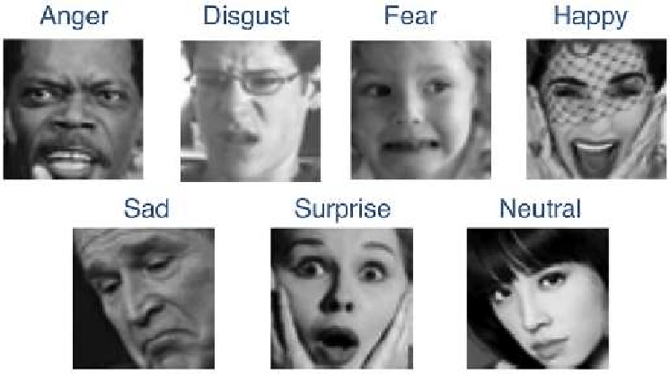
SUMMARY OF MODULE-1
The dataset is from a Kaggle Emotion Detection FER - 2013 dataset and is used for training and testing. It comprises pre-cropped,48-by-48-pixel grayscale images of faces each labeled with one of the 7 emotion classes: anger, disgust, fear, happiness, sadness, surprise, and neutral.
30-05-2024

Slide 14
SUMMARY OF MODULE-2
The input video in the emotion detection may contain noise and have variation in illumination, size and color. It involves identifying and extracting relevant features from the facial images that can be used to recognize different emotions. To get accurate and faster results, some preprocessing operations were done.
30-05-2024

Slide 15
SUMMARY OF MODULE-3
Utilizing advanced deep learning architectures such as Dense Convolutional Neural Networks (Dense CNNs) we feed the training set into the model, allowing it to learn and discern patterns and features associated with different emotions.
30-05-2024

Slide 16
SUMMARY OF MODULE-4
Model testing involves assessing its ability to accurately recognize and interpret emotions on unseen data. We utilize the testing set, which comprises a diverse range of facial images not encountered during training, to measure the model's predictive accuracy and generalization capability.
30-05-2024

Slide 17
REFERENCES
Ratyal N, Taj IA, Sajid M, Mahmood A, Razzaq S, Dar SH, Ali N, Usman M, Baig MJA, Mussadiq U (2019) Deeply learned pose invariant image analysis with applications in 3D face recognition. Math Probl Eng 2019:1–21.
Facial expression recognition for monitoring neurological disorders based on convolutional neural network Multimed. Tools Appl., 78 (22) (2019)
Facial expression recognition with Convolutional Neural Networks: Coping with few data and the training sample order Pattern Recognit., 61 (2017), pp. 610-628.
Y. Li, J. Zeng, S. Shan, et X. Chen, Occlusion Aware Facial Expression Recognition Using CNN With Attention Mechanism,IEEE Trans. Image Process., vol. 28, no 5, p. 2439‑2450, mai 2019, doi: 10.1109/TIP.2018.2886767.
30-05-2024

Slide 18
THANK YOU

